Slide 1
Deliverable # 2
NETFLIX
Consultant: Izaz Ahmad
Stakeholder: Ned Hulseman

Slide 2
Recommendation System
Objective: The purpose of this recommendation system is to personalize content based on user features, such as subscription types, Device types, Age, Country, etc.
Approach: To make an effective recommendation system we will use clustering by device type, subscription type, Age, and Country. Clustering through K-Means will enable us to create a recommendation system that recommends content based on similar user features.

Slide 3
Crucial Dataset Elements For Recommendation
There are multiple components in the Dataset that will be valuable to our recommendation system.
Key components include:
User Demographics: Age and Country data are critical in tailoring content based on location and user trends.
Device Type: Device information (such as a laptop, TV, tablet, or smartphone) guides suggestions, enhancing the format and duration of content for the viewing device.
Subscription Type: Subscription type such as Basic, Standard, and Premium, impacts a user’s access to content, allowing us to recommend content based on subscription type.

Slide 4
Value To Stakeholders
Enhanced User Experience: This recommendation system will increase user engagement due to personalized content, decreasing search time and improving customer experience.
Increased profits: Higher watch time due to accurate recommendation and improved customer experience will lead to customer retention and possibly a subscription upgrade, increasing revenue.

Slide 5
Limitation Of Dataset
Limitations:
Missing data: Data regarding user content preferences is not included, such as Genre preference (Action, Drama, etc.) and content type (Movies, Shows, etc.). This is a major limitation that reduces recommendation personalization.
Lack of Diversity: Data lacks diversity in country (mostly Western Countries) and small age range (ranges from 26 to 51), making it difficult to make a global recommendation system.
Lacks Content Data: The dataset is mainly about user information, it lacks information such as movies and shows.

Slide 6
Mitigation Strategies
Handling Missing Data: We will apply broader recommendation criteria to make up for missing data, by recommending content based on similar features among similar groups. Clustering (K-Means) will enable us to group users based on similar features.
Data Cleaning: Cleaning data by eliminating missing values, standardizing Data formats, and Transforming data (fitting categorical values) will improve recommendation accuracy and data quality.
Using Content Dataset: Since the User dataset lacks information about content such as movies, shows,etc. We will use a different dataset that includes content data and apply the recommendation system on that data.

Slide 7
Data Quality
Overall the data quality is good, however there are some challenges such as:
Inconsistent data formats for date-related columns such as join date and Last payment date.
The data is old and outdated, the revenue and subscription information is from 2022.
Mitigation:
As mentioned before, to improve data quality, we need to clean the data. Such as using standard date formats, removing missing data.

Slide 8
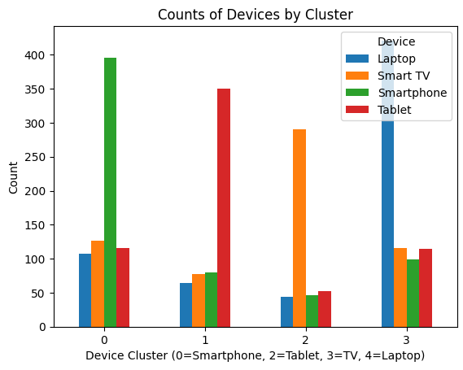
Preliminary Insights - 1
Device Clusters: TV and Laptop users prefer longer content, whereas Smartphone and Tablet users prefer shorter content. Users are clustered based on device type and they receive different recommendation based on each clusters.

Slide 9
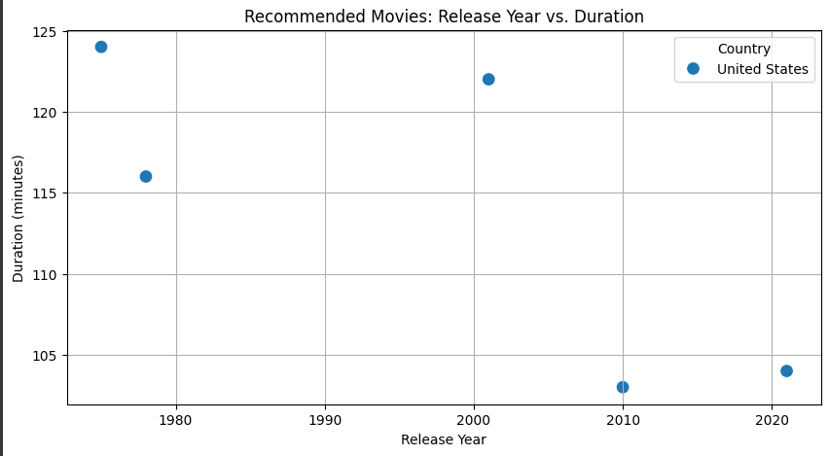
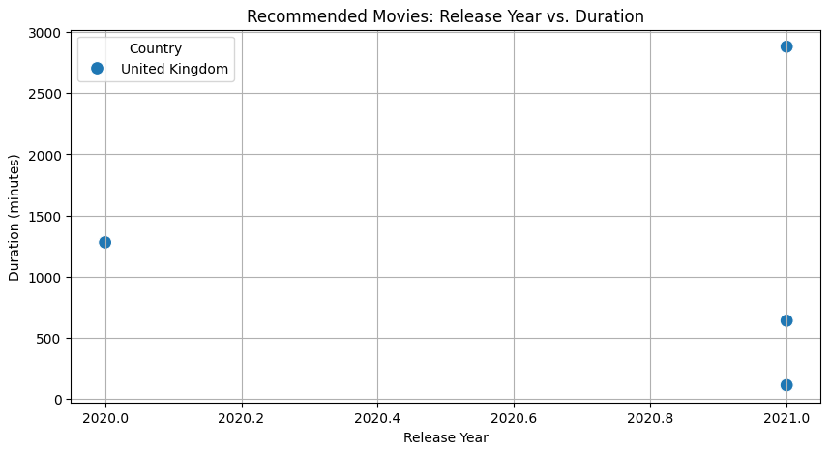
Preliminary Insights - 2
Country-Based Content Recommendation: The recommendation system recommends content based on the user’s country location and language. A person from the US will be recommended movies mainly Released in the US.
US User:
UK User:

Slide 10
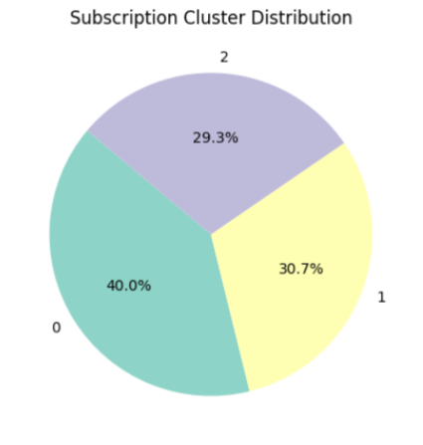
Preliminary Insights - 3
Subscription Type Trend: The recommendation system will recommend content based on subscription type. Premium users will be recommended content that is newer, whereas standard users will be recommended movies that are older. Also combining other features such as Age and Country will increase the accuracy of the recommendation system.

